Slide 1
Simultaneously Reinforcement learning and Advising via Differential Privacy
Authors: Sheng Shen, Tianqing Zhu, Dayong Ye, Mengmeng Yang, Tingting Liao, Wanlei Zhou
Speaker: Sheng Shen
02/04/2019

Slide 2
Content
Advising
Simultaneously advising
Scenario setting
Problem definition
Why differential privacy:
  Convergence of Q-value
  Dataset of actions
Algorithm and Experiment results
What we can improve

Slide 3
Advising
Purpose : Accelerate Traditional Reinforcement Learning
Teacher-Student Framework
  Teacher / Advisor
  Student / Advisee
Communication Budget – in real world
  b_{give}
  b_{ask}
Advising Confidence (knowledge gap)
  P_{give}
  P_{ask}
  Execution times

Slide 4
Simultaneously Advising
Simultaneously
  No experienced teacher
  All agents learn simultaneously
  Multi-agents, Multi-tasks, Multi-actions
  Knowledge gap

Slide 5
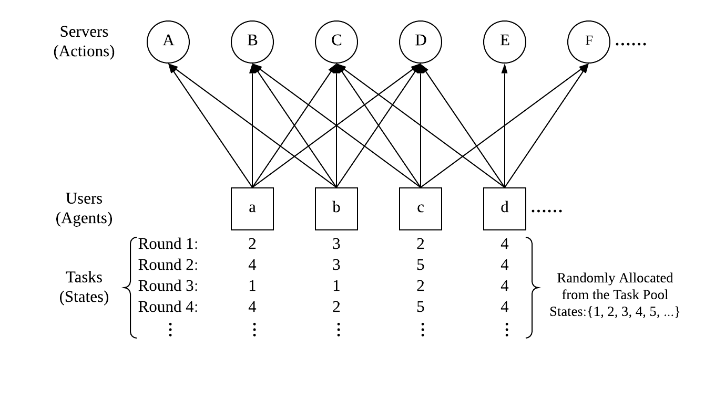
Scenario Setting

Slide 6
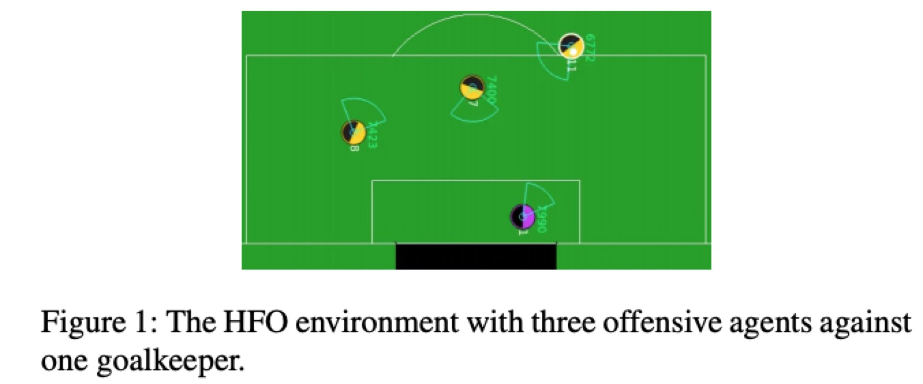
Problem definition
Limitation:
  Most current research – same actions

Slide 7
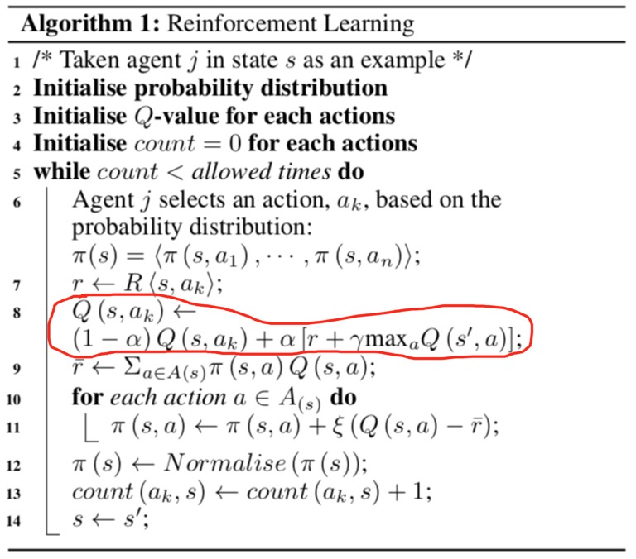
Why Differential Privacy?
Q-value and its convergence
  Variables
    Current Q-value,
    Reward
    Alpha
    (next state’s Q-value)
  Q-value is convergent to
    Reward
    Interaction with Reward & Next State’s Q-value

Slide 8
Why Differential Privacy
Same datasets
  Same actions
Agent 1
Q(s,a₀) | m₀
Q(s,a₁) | m₁
Q(s,a₂) | m₂
……
Q(s,a_{n}) | m_{n}
Agent 2
Q(s,a₀) | m₀
Q(s,a₁) | m₁
Q(s,a₂) | m₂
……
Q(s,a_{n}) | m_{n}

Slide 9
Why Differential Privacy
Neighbouring datasets
  Actions differing in one
Agent 1
Q(s,a₀) | m₀
Q(s,a₁) | m₁
Q(s,a₂) | m₂
……
Q(s,a_{n}) | m_{n}
Agent 2
Q(s,a₀) | m₀
Q(s,a₁) | m₁
Q(s,a_{p}) | m_{p}
……
Q(s,a_{n}) | m_{n}

Slide 10
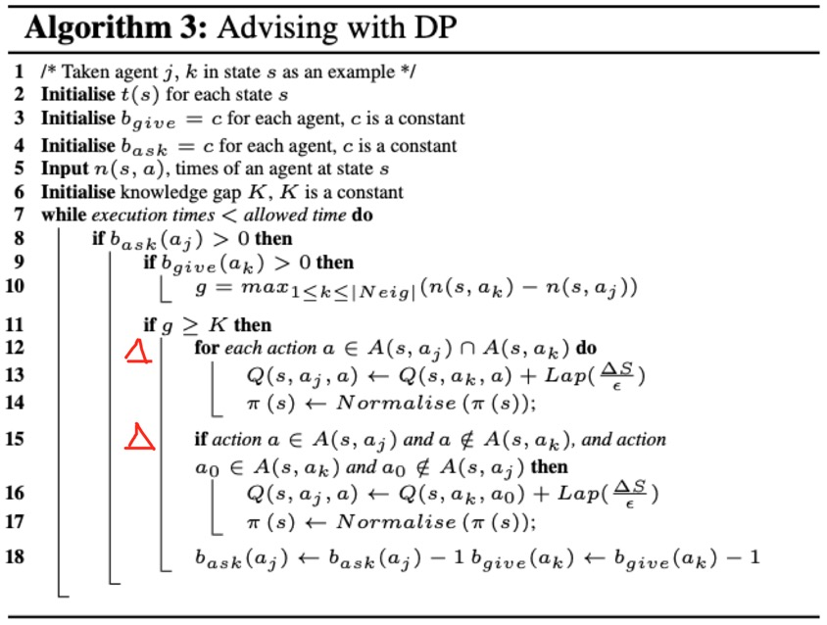
Algorithm

Slide 11
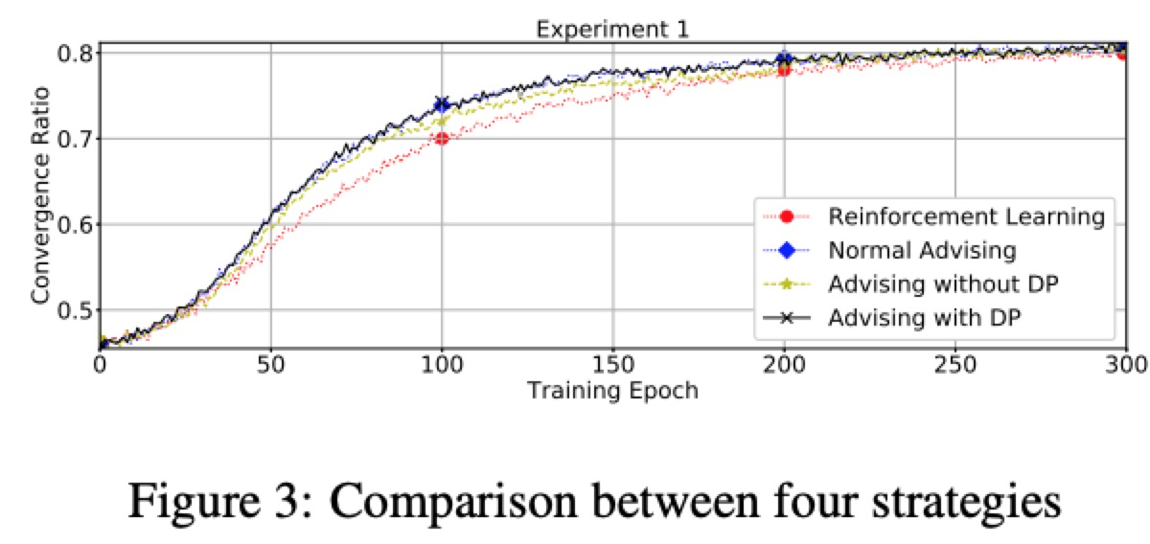
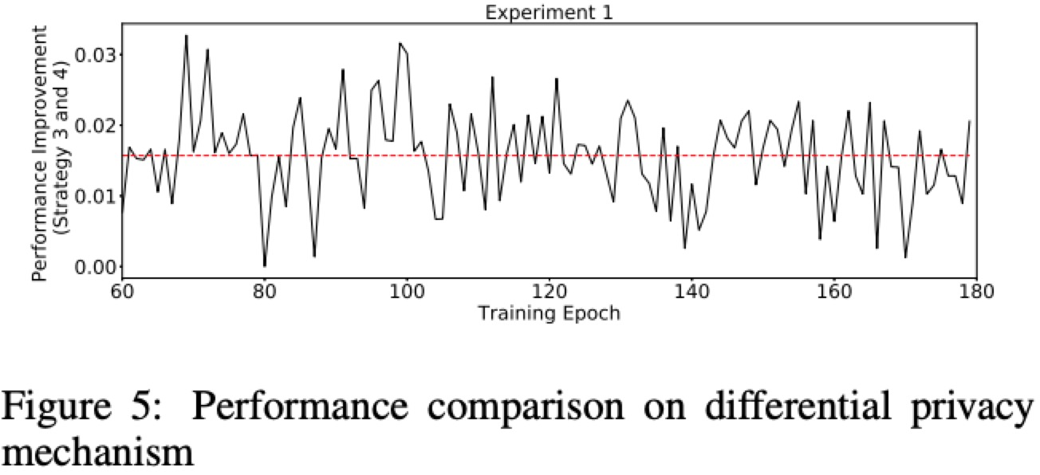
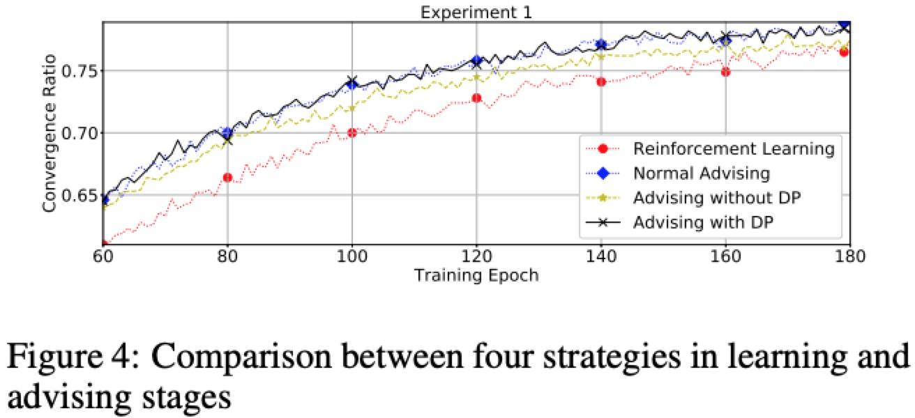
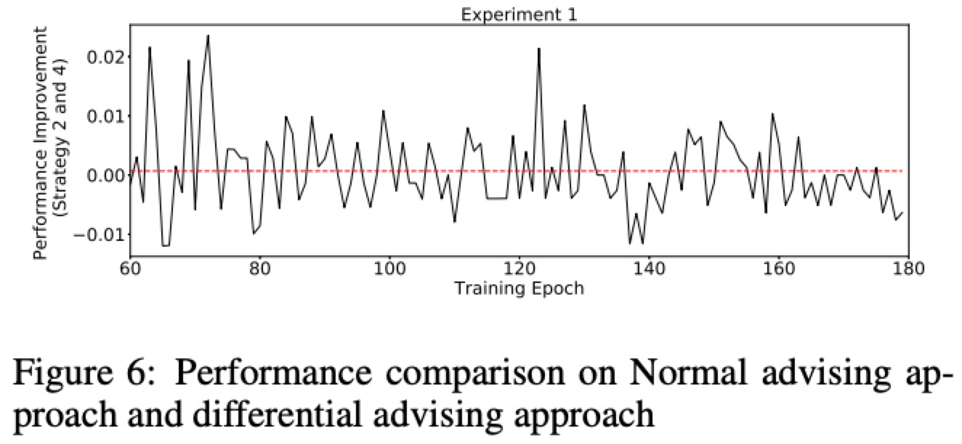
Experimental Results

Slide 12
What we can improve
Accelerate learning speed
  Differential privacy mechanism
  Weight on each action
  Definition of communication budget
  Confidence of knowledge transfer
Knowledge (reward)

